Slide 1




Micromegas for a DHCAL
LAPP, Annecy
Catherine Adloff
Jan Blaha
Sébastien Cap
Maximilien Chefdeville
Alexandre Dalmaz
Cyril Drancourt
Ambroise Espagilière
Renaud Gaglione
Raphael Gallet
Nicolas Geffroy
Claude Girard
Jean Jacquemier
Yannis Karyotakis
Fabrice Peltier
Julie Prast
Jean Tassan
Guillaume Vouters

Slide 2
Outline
Micromegas R&D for DHCAL
  X-ray and beam tests with Analog Readout
  Micromegas with Digital Readout
Simulation
Future1 m² prototype
Conclusion

Slide 3
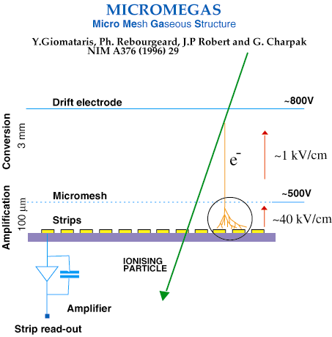






Micromegas detectors at LAPP
Description:
  Gas mix: Argon+Isobutane
  Drift and Mesh HV < 500 V
  High rate capability
  Robust, cheap (industrial process)
  Thickness: 3.2 mm
  Low hit multiplicity
  High detection efficiency
  Delicate functioning: sparks
Readout:
  Analog for characterisation
  GASSIPLEX + CENTAURE DAQ
  Digital :
  HARDROC or DIRAC +
  Detector InterFace (DIF) board +
  EUDET DAQ2 or CrossDAQ
or pads

Slide 4



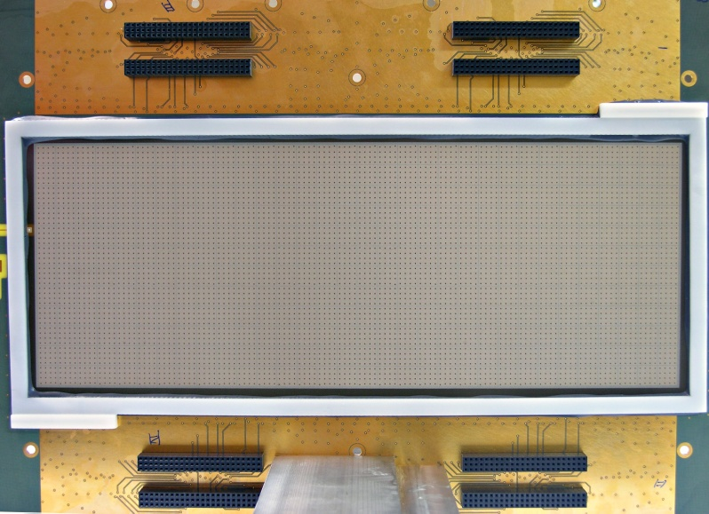
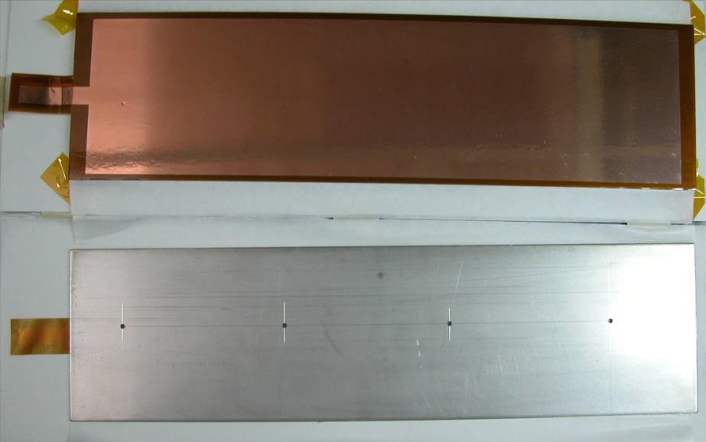
Detector layout
Bulk technology from R. De Oliveira & O. Pizzirusso
Bulk Micromegas :
  Mesh laminated on the PCB
  Industrial process
  Cheap and robust
Steel top :
  Part of the absorber
  Holes for X-ray tests
  Holds a 55 µm thick cathode
  Glued on a plastic frame 3 mm above mesh

Slide 5
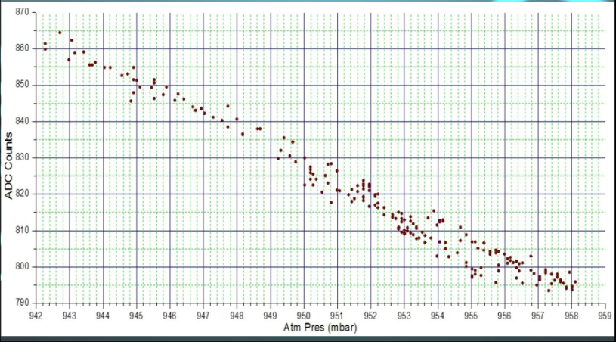
⁵⁵Fe X-ray test
Setup
  6 x 16 cm2 mesh
  Source collimated above 1 pad
  Readout mesh signals
Collection efficiency
  Plateau for field ratios larger than 50
Gas gain (assume 230 primary e-)
  Gain doubles every 20 V
  Decreases with pressure
  Max around 2.10⁴
Energy resolution at 5.9 keV
  17 % FWHM
Slope yields -2 fC/mbar
ADC Counts
Pressure (mbar)

Slide 6
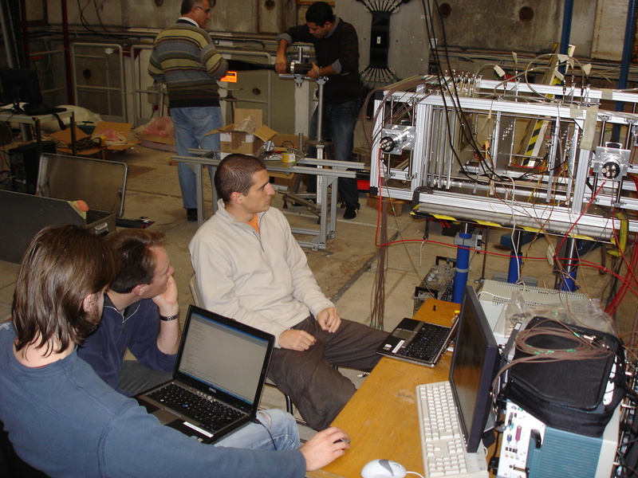
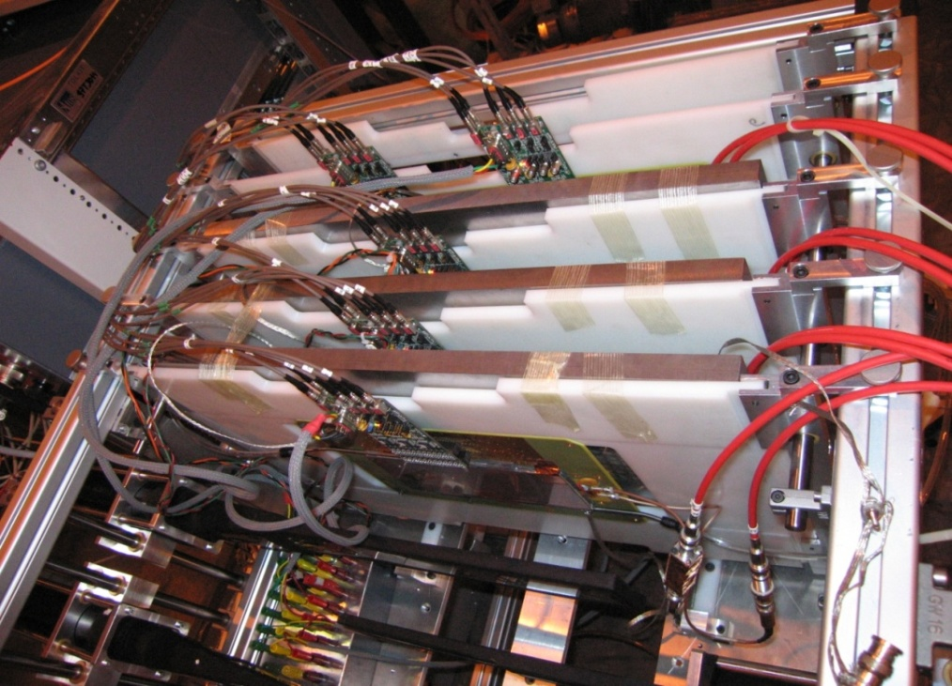
Beam test setup
T9 line at PS-CERN (Nov. 2008)
Trigger: 3 scintillators
3 Micromegas 6x16 pads
1 Micromegas 12x32 pads
Steel absorber option
GASSIPLEX readout
  VME modules (ADC) + CENTAURE
Ccharacterisation of the prototypes
  efficiency and multiplicity
  response uniformity
  X-talk studies
  behaviour in hadronic shower
Aug & Nov 2008 at CERN PS and SPS
  400.10³ Pions and Muons of 200 GeV
  250.10³ Pions with 1 steel block + absorbers
  200.10³ Pions of 7 GeV
6

Slide 7
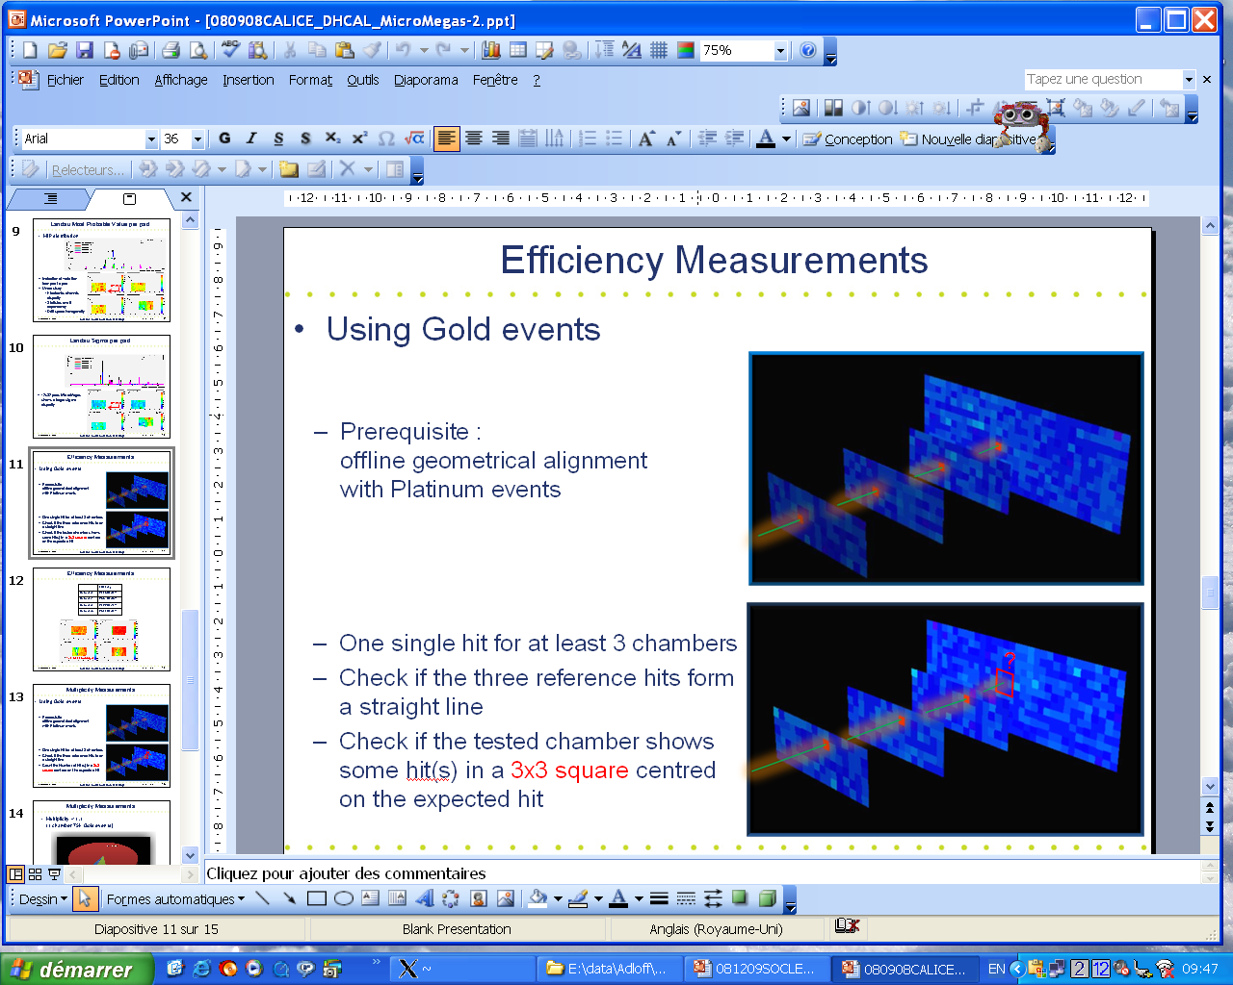
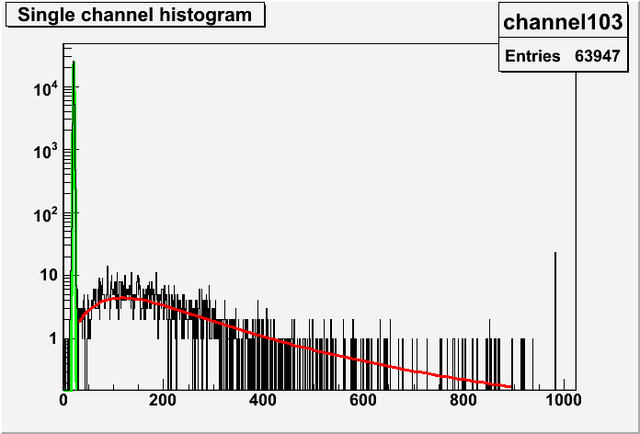
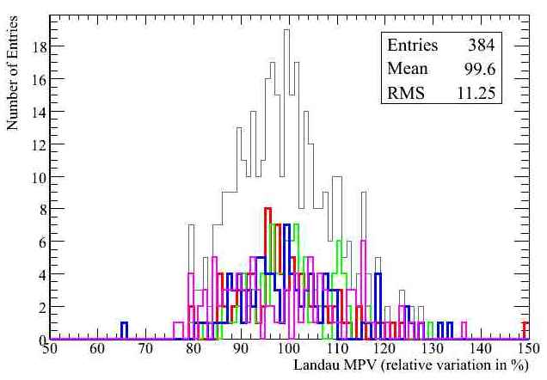
Signal distribution on each pad
Select event with one and only one hit in each chamber
  Insure all charge collected on one pad
  Hit if ADC > 27 counts
Landau distribution MPV is at 45 fC
  Shows variations of 10% RMS over all pads
platinum events
all triggers
Chamber 0
Chamber 1
Chamber 2
Chamber 3
entries
MPV ~ 45 fC
ADC counts

Slide 8
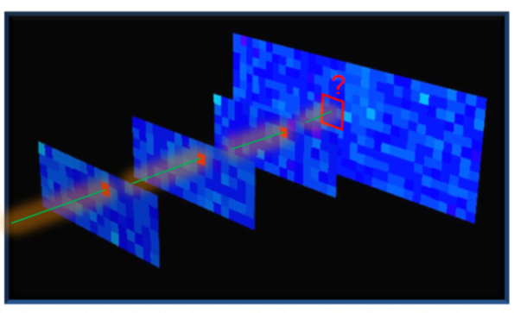
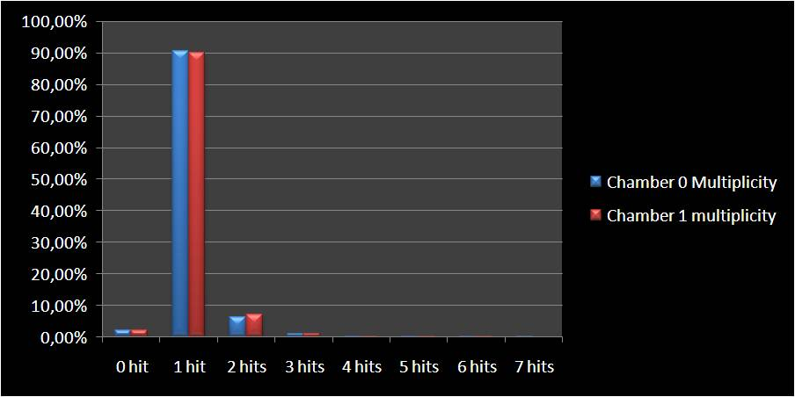
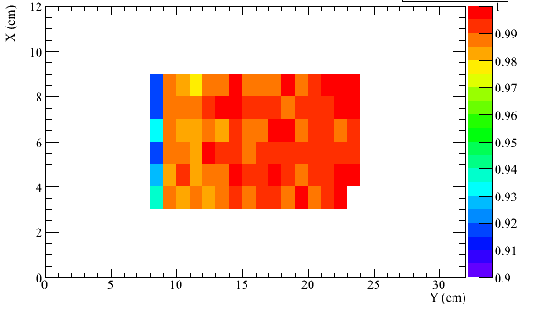
Efficiency and multiplicity
Require one and only one safe hit in three chambers
  ADC > 51 counts (5.3 fC)
  Hit position in fourth chamber extrapolated
  Count hit (ADC > 27 counts) in 3x3 pad area
Efficiency between 92 and 99 %
Multiplicity between 1.07 and 1.15
gold events
Hit multiplicity distributions of 2 chambers
Efficiency map of one chamber

Slide 9
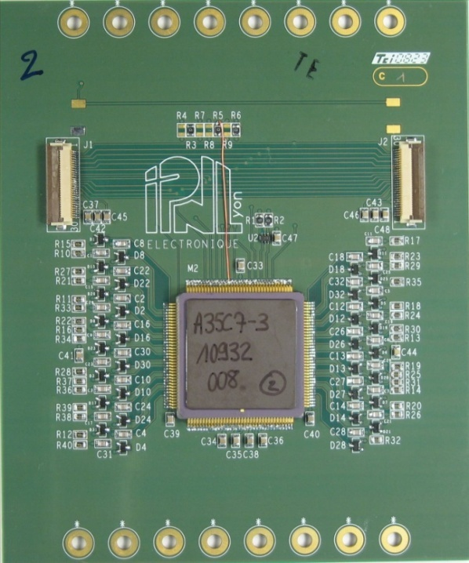
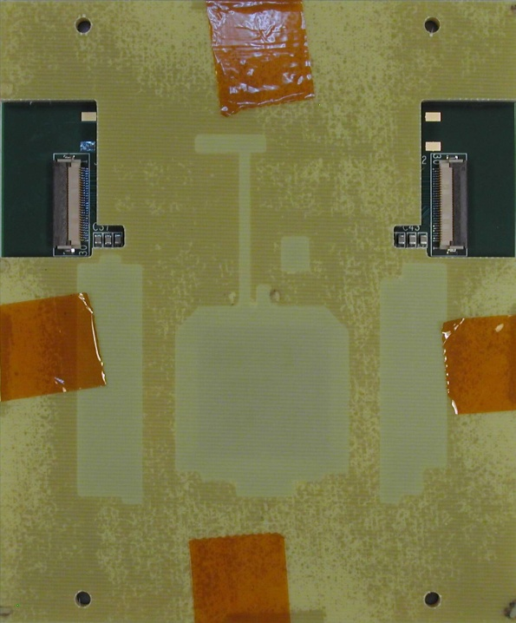
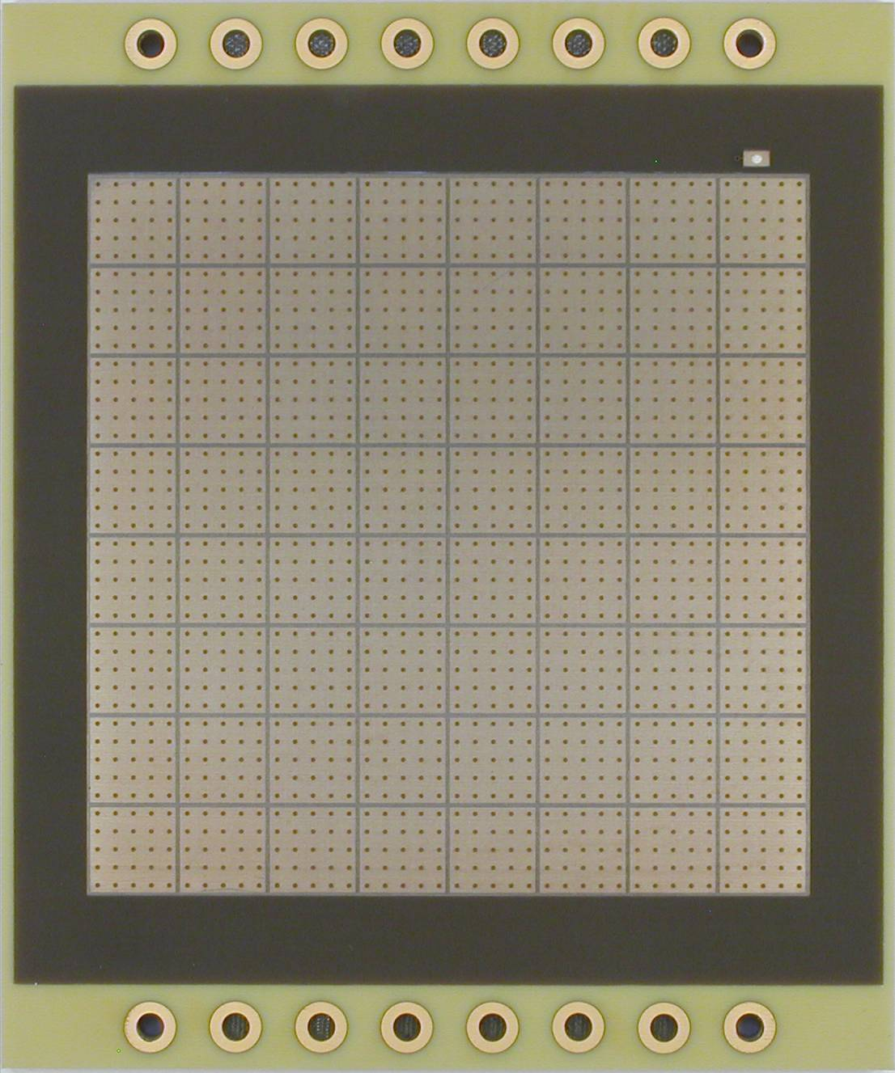
Micromegas with Digital readout
PCB with DIRAC1 64 channels ASIC (R. Gaglione, IPNL)
  Digital link to DAQ (possibility to chain detectors)
  3 thresholds and 2 gains (RPC and Micromegas modes)
  Synchronous architecture
First operational Bulk Micromegas with embedded readout electronics !
Bulk from R. De Oliveira & O. Pizzirusso
DIRAC
9
Sparks protections
mask for bulk laying
8x8 pads with bulk

Slide 10
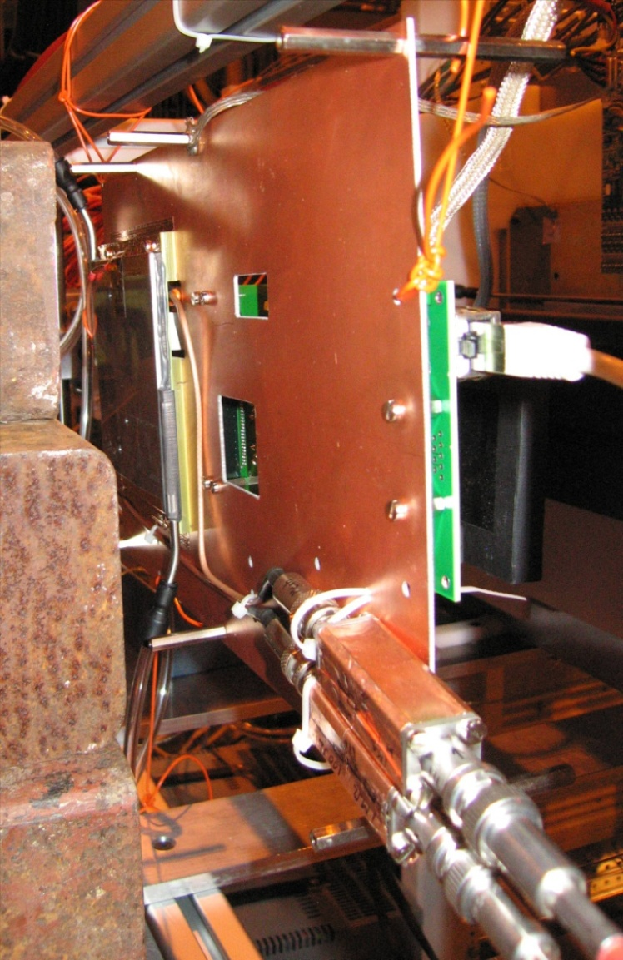
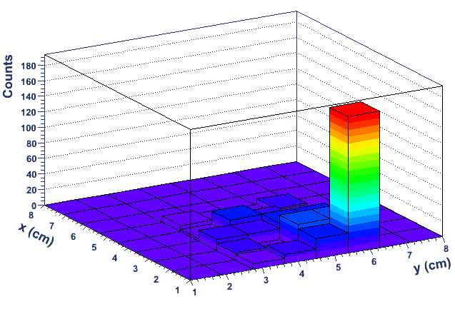
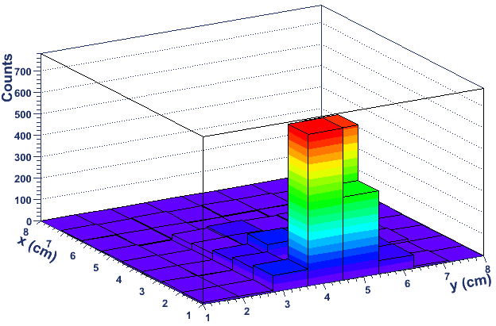
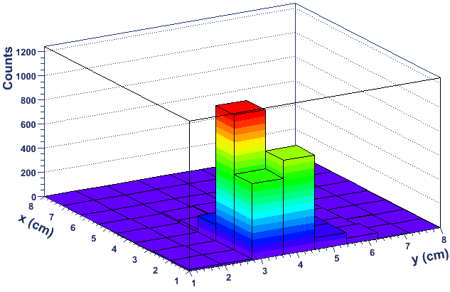
Micromegas with digital readout
Tested during August 2008 test beam
Minimum threshold of 19 fC
Only one detector available
  No efficiency/multiplicity measurements yet
  Prepare more prototype for next beam test
Beam Profile
when moving
the X-Y table

Slide 11
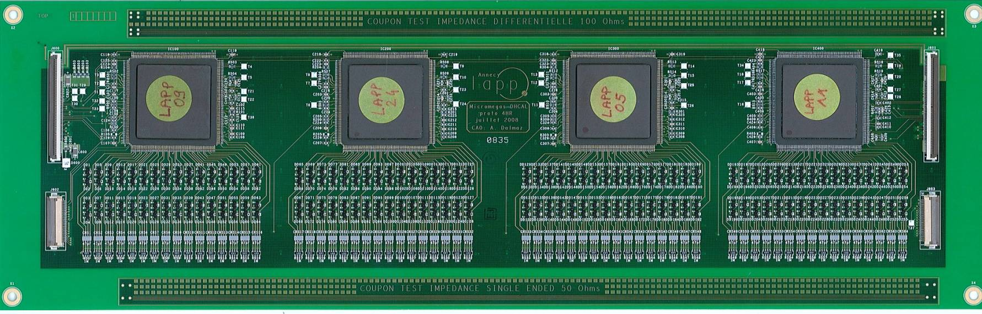
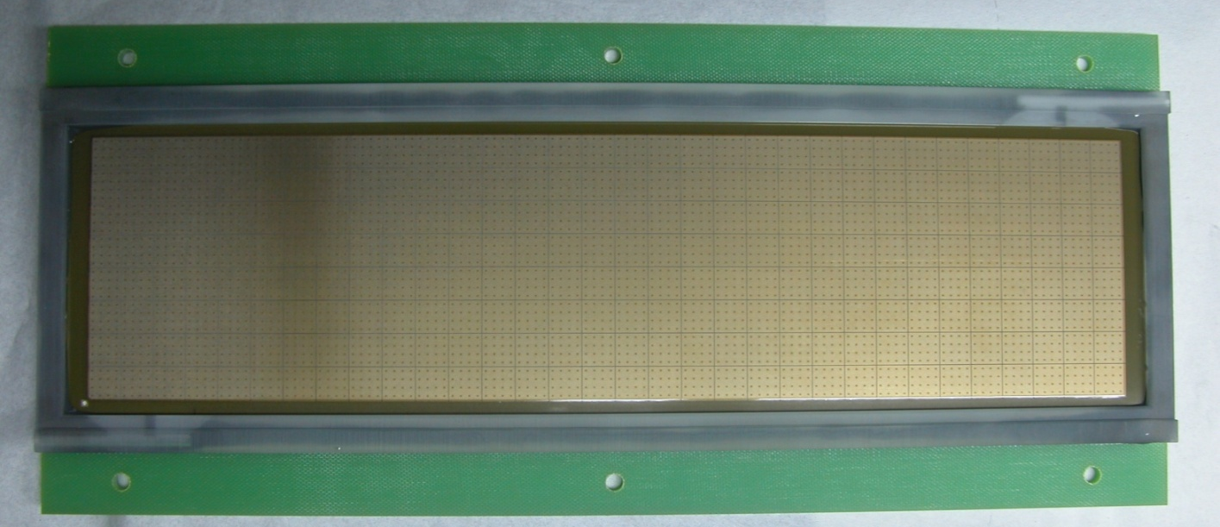
Micromegas with digital readout
PCB with 4 HARDROC1
  64 channels ASIC, detector active area 8x32 cm²
HARDROC1
sparks protections
bulk
11

Slide 12
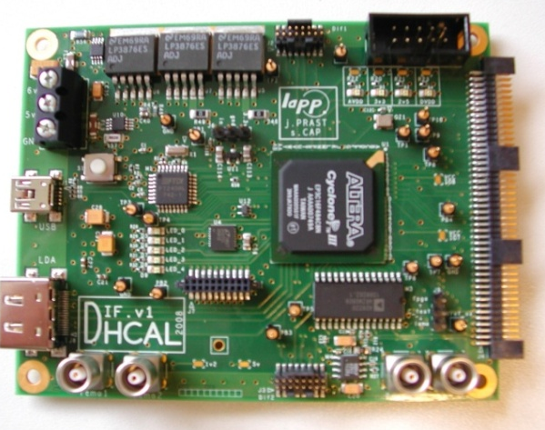
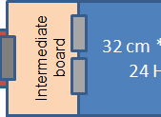
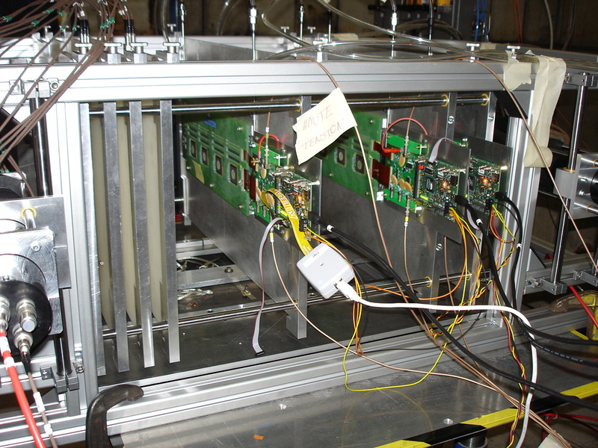
Micromegas with digital readout
Readout : DIF board
  Separated from the SLAB
  For large number of ASICs
  HARDROC, DIRAC and also
  SPIROC and SKYROC
  DIF task force interface : USB or EUDET DAQ
Tested during the November 2008 TB
Excellent work from Guillaume Vouters (DIF) and Christophe Combaret (CrossDaQ)
HV stability issues during tests
Data (almost) under study
PCB
with ASICs

Slide 13
Simulation
Tools
  SLIC full simulation (Geant 4)‏
  Analysis using JAS3
2008 beam test setup
DHCAL with Micromegas
  Comparison between analog, digital and semi-digital
  Thresholds & absorber studies

Slide 14
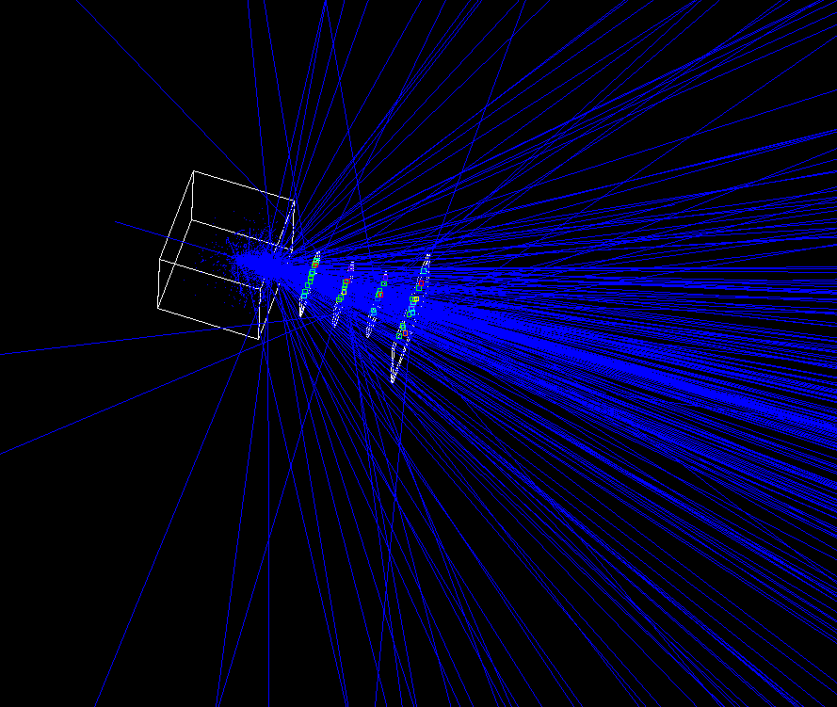
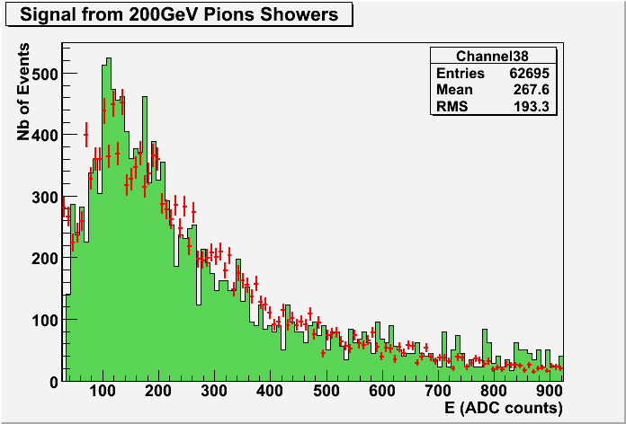
2008 beam test setup is being simulated
  Comparison with real data
  Better understanding of our detector
  Preparation for next test beam
Simulation
Test beam
30 cm iron absorber in front

Slide 15
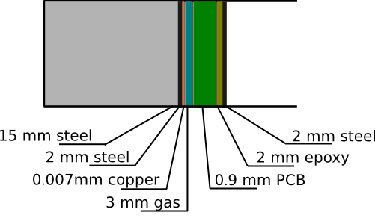
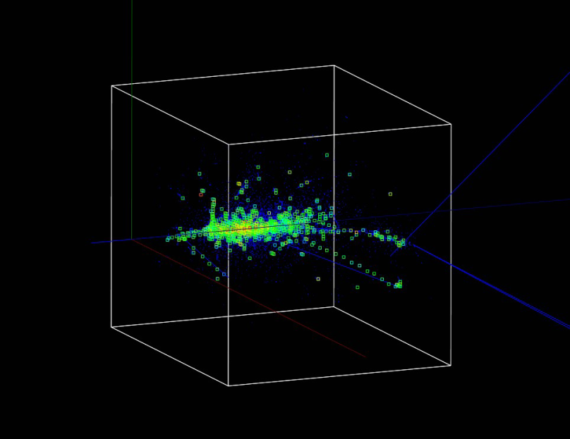
DHCAL with Micromegas
Full 1 m² geometry implemented
  Readout: from 0.5 x 0.5 cm2 to 4x4 cm² pads
  3 mm drift gap
  Gas mix. Argon/Isob. 95/5
  1.9 cm thick absorber between layers
  different absorber materials
  40 or 80 layers (~4, 5 or ~9 λ)
  Thickness of active layer: 3.2 mm
  Ideal Micromegas, digitization not yet fully implemented
DHCAL 40 planes
100 GeV Pions

Slide 16
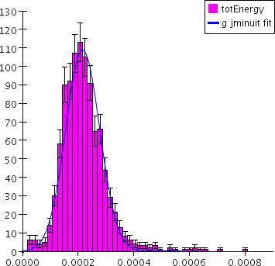
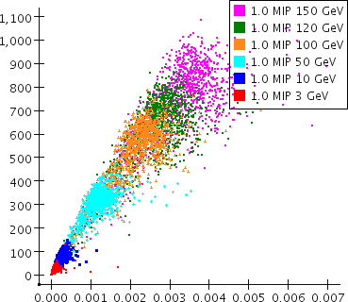
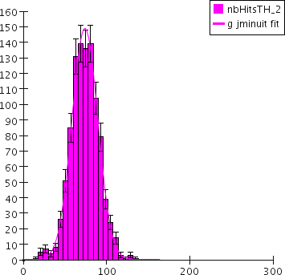
Sum up hits and energy in all cells
Apply a single threshold (1 MIP)
Look at distributions RMS
Nb of events
Analog
response
at 10 GeV
Nb of Hits
Nb of Hits
Nb of events
Digital
response
at 10 GeV
Pions
1 MIP threshold
1 MIP threshold
E(GeV)
Nb of Hits

Slide 17
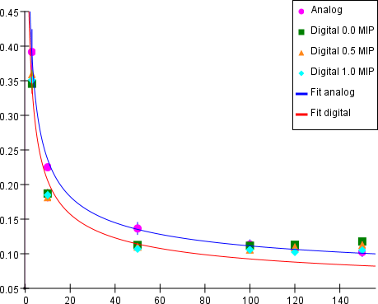
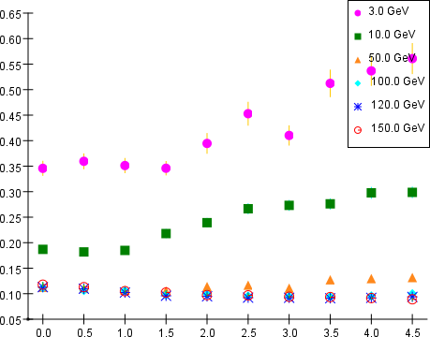
Energy resolution
Pion energy
Hit threshold
σ_{E}/E
σ_{E}/E
E (GeV)
Threshold (MIP)
Worse resolution at High energy
⇒ Need more than 1 threshold ?
Threshold range with constant energy resolution
A lot more is under study …

Slide 18
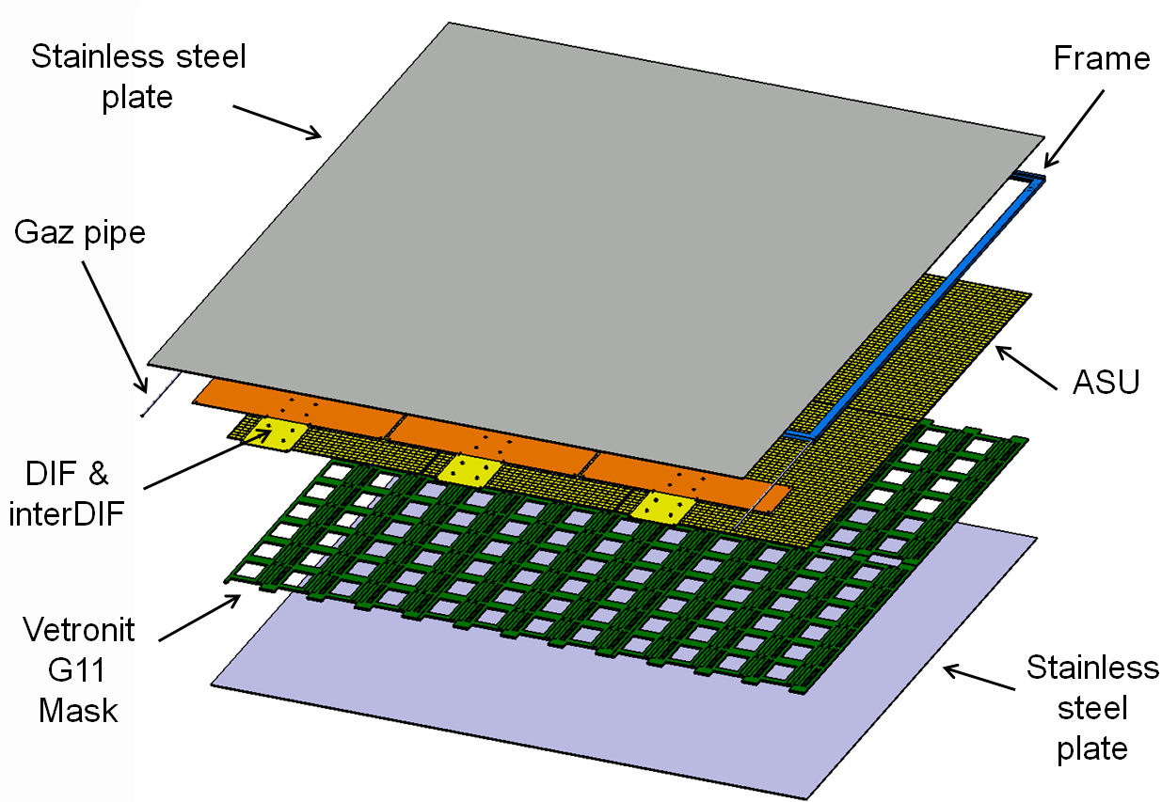
Future 1 m² prototype: 6 Active Sensor Units
9 216 channels - 96 x 96 cm² active area - 3 DIF + interDIF boards

Slide 19
1 m² prototype status
DIF & DAQ almost ready
ASU :
  24 HARDROC2
  Design and routing done
  Single ASU test box under conception
Mechanical prototype under construction

Slide 20
Conclusion
Micromegas R&D for DHCAL very active!
  ASIC developments
  Innovative prototypes, first digital readout prototypes
  Tests Beam: very promising results (still a lot to analyze)
  Beam tests planned in 2009, first in May
Next steps
  1 m² prototype should be ready for test before 2010
  Calorimeter prototype of 1 m³
In parallel : work on simulation
  TB prototypes, future 1 m³ and leakage less 8 m³
  Different absorber material, active medium, pads size…

Slide 21
Thanks for your attention
Acknowledgements
Catherine Adloff
Jan Blaha
Sébastien Cap
Alexandre Dalmaz
Cyril Drancourt
Ambroise Espagilière
Renaud Gaglione
Raphael Gallet
Nicolas Geffroy
Claude Girard
Jean Jacquemier
Yannis Karyotakis
Fabrice Peltier
Julie Prast
Jean Tassan
Guillaume Vouters

