Slide 1
CARACKMON

Slide 2
CARACKMON
The goal of the CARACKMON project's :
Control the racks power supply
Project exist but we rewrite the project
Create a new component : lbRackMon
Last version: 1.1.0
Installation of component in CARACKMON project’s
rewriting of main panel

Slide 3
An user interface very simplified
An generic user interface
Use the component 3Dviewer
dynamic interface(zoom, rotation, move, view)
development of a code to parse "xml" files, and generate dynamic user interface in 3Dviewer
Every part's is linked with a data point
Each part's can be linked with a real objet to control (an another Data Point)
Value of temperature, current, voltage etc.

Slide 4
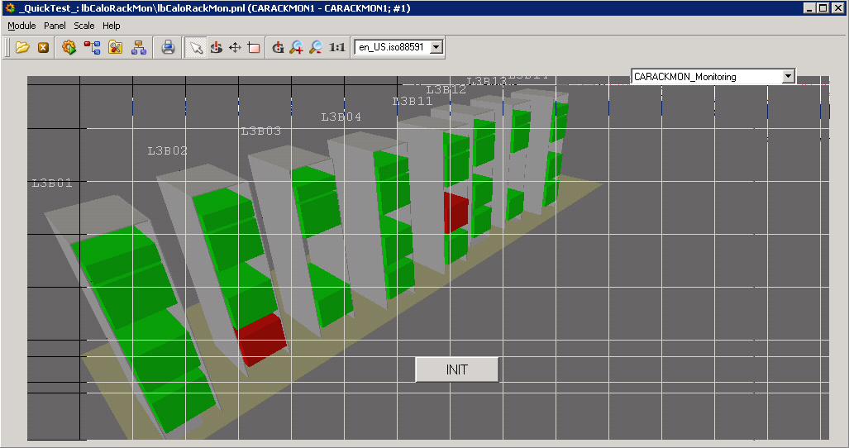

Slide 5
The state of turbine of L3B01 rack .

Slide 6
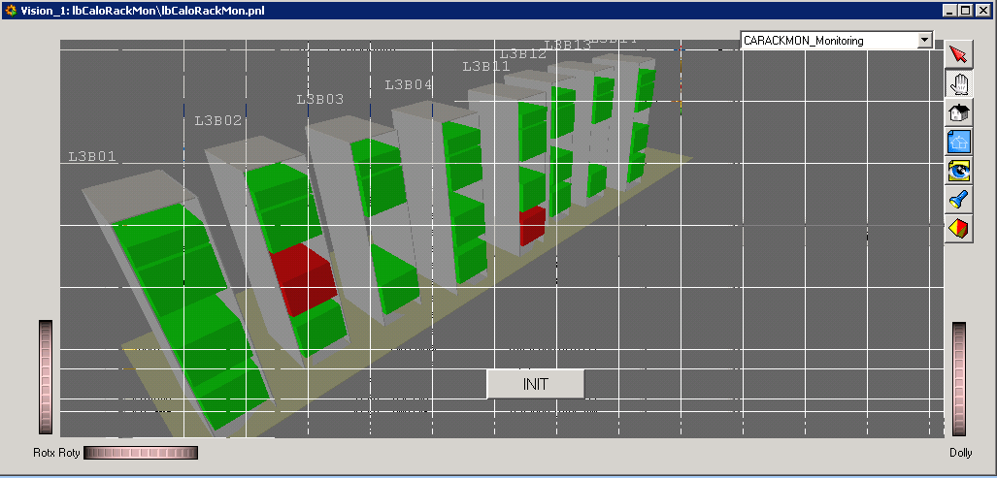
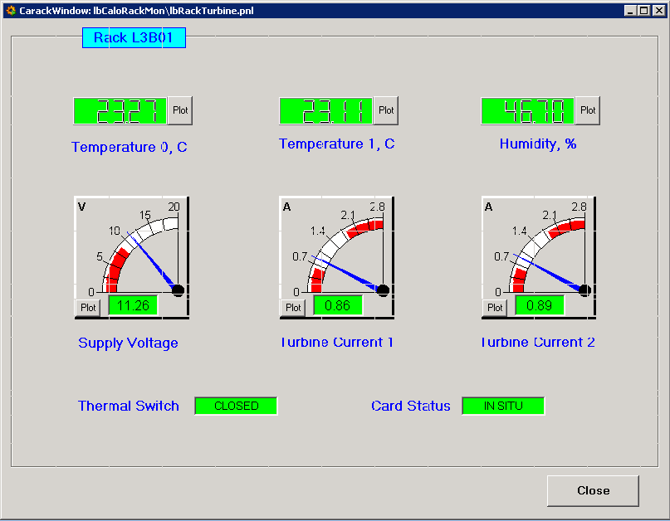
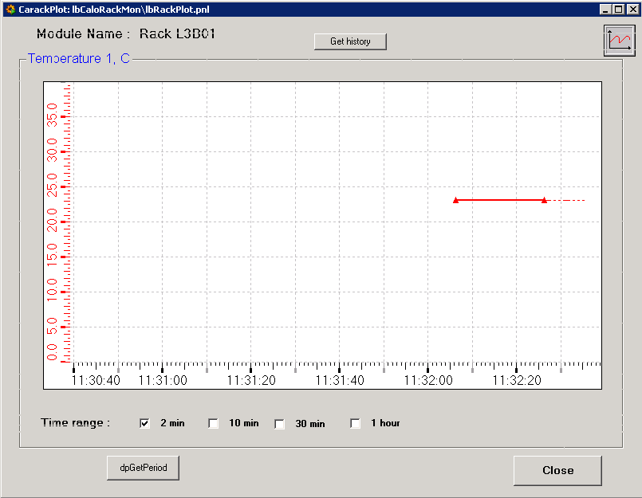
You can control the turbine easily and show review

Slide 7
Example pb with one Crate

Slide 8
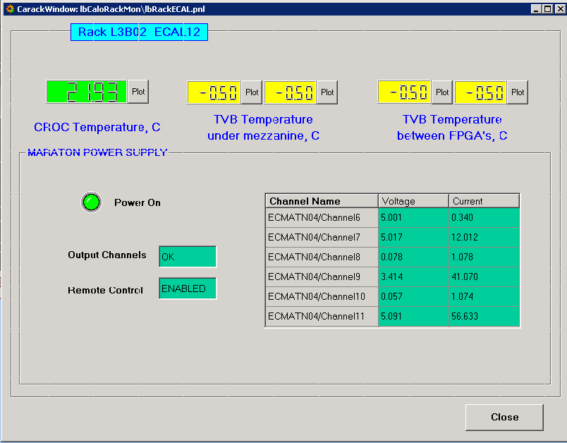
Example: Here pb of temperature reading

Slide 9
you can also start external programs just by changing this selector.

Slide 10
When you click on one element

Slide 11
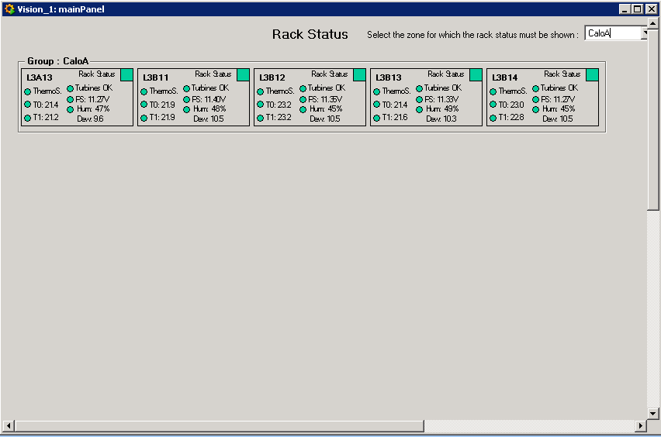
You start an another program

Slide 12
CARACKMON
Conclusion :
CARACKMON installed in « CADCS02W » computer
Version 3.6 (not 3.8)
The Project don’t start automatically (manual mode)
No « shortcut » (call the main panel).

